Slide 1

MINGLE BOX
Batch : B6
Guide : B.Sreedhar
M.Tech., Assistant Professor
P.Prathibha Y.Sindhu V.Sandhya B.Priyanka N.Vishnu Priya
-154G1A0563
-154G1A0583
-154G5A0579
-154G1A0565
-154G1A05A7
Srinivasa Ramanujan Institute of Technology
Department of Computer Science & Engineering

Slide 2

Abstract
Mingle Box is a marketplace where people who need custom software development can find coders in a safe and business- friendly environment. Buyers can pick from a pool of registered coders.
Coders and buyers both can be benefited from this Bidding. It allows coders to access a huge pool of potential work and have the ability to work independently from their homes rather than for a company .

Slide 3
Contents
Problem Definition
Literature Survey
Proposed System
Features
Modules
Project Planning
Project Schedule
References

Slide 4
Problem Definition
Mingle box is a place where buyers and coders are interact with each other.
The current application suffices the requirements of both people,those who are looking for automating their business and also the people who are freelance programmers.

Slide 5
Literature Survey 1.Existing System
The present existing system of this project is the bidding is done through the manual and stick to the region and based on the boundaries .Through the present bidding getting profits on the project is very less.

Slide 6
2.Limitations
Buyers can hire coders within the limited area only. They can’t work with world wide coders.
There is no mutual understanding between buyers and coders.
Finding of coders for these requirements takes much time.

Slide 7
Proposed System
The proposed system is solution for the current bidding process. Our system gives profit on the project and bidding is not done through manual or not stick to the region and based on the boundaries.
Buyers can select coders through bidding process.

Slide 8
Features
Registration of Buyers
Registration of Coders
Adding projects
Selecting coders

Slide 9
Modules
The application comprises the following modules
Administration : The administration facilitates registering the buyers and coders.
Coders : The coder can post his/her profile with the expertise information in migle box.
Buyers : The role of a buyer is to post the projects for bidding in mingle box.

Slide 10
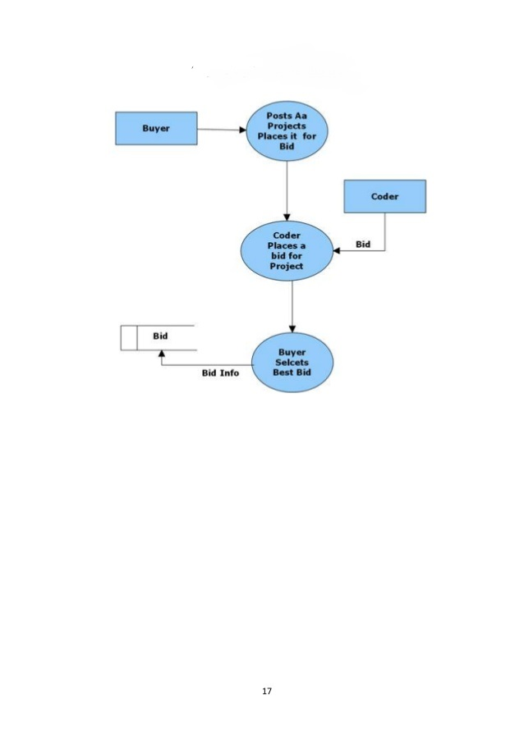
Project Planning

Slide 11
Project Schedule
Week 1 :Study of Literature Survey
Week 2 :Integration and Design
Week 3 :Implementation
Week 4 :Testing
Week 5 :Documentation

Slide 12
Abstract review Comments
Study of Existing system.
Buyers select the coders through tender process.

Slide 13
References
https://www.scribd.com/document/83350414/MingleBox-Abstract
https://www.studentprojectguide.com/computer-science-projects/mingle-box/

Slide 14


Queries
THANK YOU

